Slide 1
Improving the Modeling of Truck and CVs
Using GPS Truck Big Data in NYMTC’s Truck Model
2025 Modeling Mobility Conference
Brent Selby, John Gliebe (speaker)
September 17, 2025

Slide 2
Truck Model Objectives
Truck trips
Light trucks/commercial vehicles
Medium trucks
Heavy trucks
Commercial trips only
Freight
Non-freight
Passenger trips modeled in the ABM
Region – NYMTC
NY-NJ-CT
Large, complex
Trip types
Internal (I-I)
Internal-External (I-E)
External-Internal (E-I)
External-External (E-E)
Notes:
Overall description of the model
Give background for what we are talking about and what the model does.
This can be short as people at MoMo are probably fairly aware of what truck models are.

Slide 3
Model Structure
Long Distance Model
IE/EI, EE trips
Previously included all >50 mi
FAF based
Short Distance Model
I-I trips
3 step model
Now LOCUS Truck based
Maintained submodels in update
FAF Flows
Disaggregation
Trip Generation
Sub-Model
Payload Factors
Trip Distribution
Sub-Model
Empties and Balancing
II
Trip Table
IE/IE/EE Trip Table
Assignment
Notes:
More background
Important to know, but not that hard hitting.

Slide 4
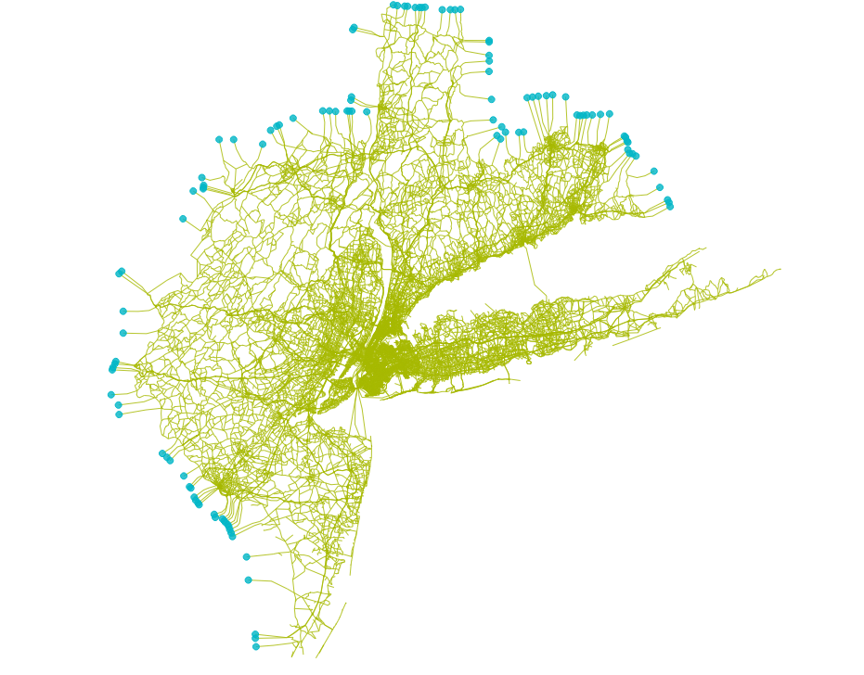
Previous Model
FAF data used for all trips above 50 miles
Best data available
Aggregate FAF zones
Short distance based on surveys
Trips rates and avg distances from other times/places
Gravity model for distribution
Limited underlying data
Notes:
We want them to understand how it was done in the past and why.
This sets up the next slide and how/why we can improve it.
At the time this was created FAF was the available data (so it was stretched to be applied as much as possible)
Subtext: the data they had on short distance trips was minimal and came from other places years before. There was a patchwork of assumptions and estimates.

Slide 5
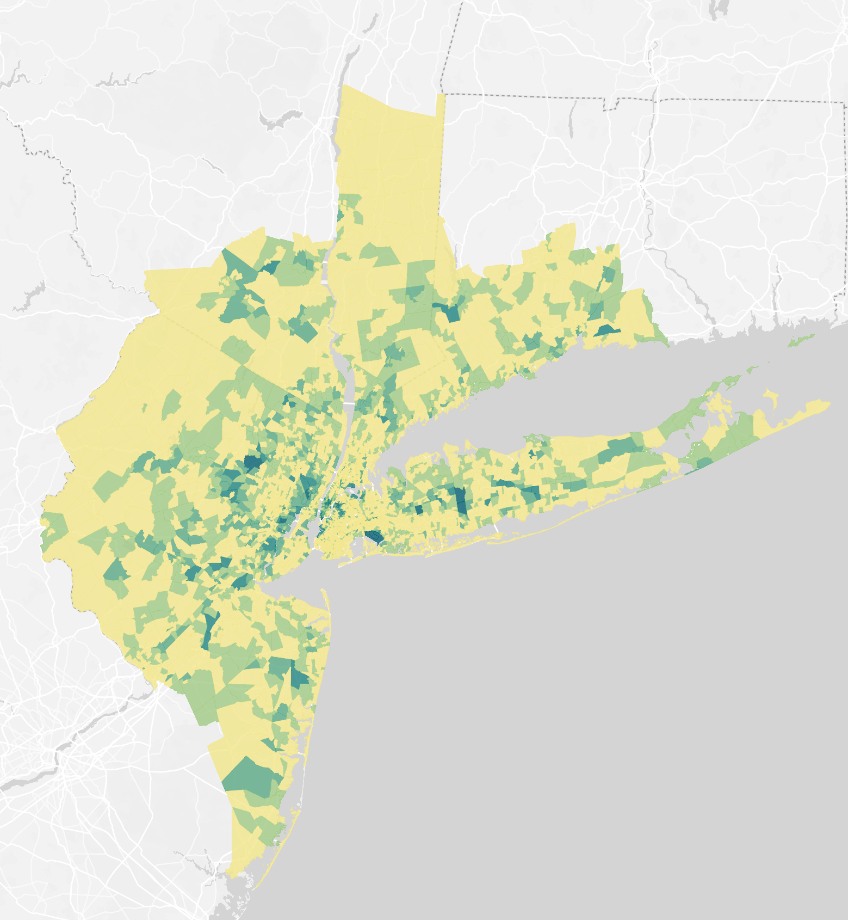
Updated Short Distance Model with LOCUS
GPS-based LOCUS Trucks
Local and comprehensive
Recent - 2023 data
Actual, expanded truck trips
Much more disaggregate
New short distance model
All internal trips
Estimated with LOCUS Trucks
Destination choice replaced trip distribution
Segments
Vehicle weight
Time of day
Truck behavioral pattern
Notes:
Behold: data. Better input data means better model output.
We can now produce a model based on real truck trips that happened in the region.
The data set is huge and disaggregate – we used the TAZs.
(map shows trip generation by TAZ)

Slide 6
Model Estimation
Trip generation
Estimated by TAZ
Driven by employment
Included accessibility indices (AI)
Destination Choice
Results varied by vocation, time
Used travel time, employment, AI
Both segmented fully
Possible with large data size
Vocation Name | Behavior
Door-to-Door | Frequent, Short Stops
Hub and Spoke | Multiple round trips with base location
Local | Limited geographic range of activity
Regional | Wider range, but returns to location
Long-Distance | Wide range, does not frequently return
Notes:
We used the LOCUS OD table to get trip generation by TAZ and then estimated the model.
Trip gen model used employment and acc indices
Destination choice also used the LOCUS OD table with travel time, employment, and acc indices as variables.
(if asked, tolls were tested but not significant. Commercial travel may react to tolls in routing, but not really in destination choice)
We estimated coefficients for each segment – vocation and time of day – for each submodel. This is not possible with a small dataset.
Using the segments the model could better capture the distribution patterns of trucks, especially their trip length distributions.

Slide 7
Conclusions
Big Data has changed the game for truck modeling in development and estimation
Better inputs make better models
Precision/accuracy
Timeliness (recent data)
Locality
Sample size
Expansion
Notes:
Reiterating – we have precise, accurate, recent, carefully expanded data from real truck trips in the NY region
If you do not like this slide you can change it or even drop it

Slide 8


Brent Selby
bselby@camsys.com
John Gliebe
jgliebe@camsys.com
Thank You for Your Time
Please reach out with additional questions or queries.

